Slide 1


Hand-Gesture Recognition
Guided by:
Mr. Ravi Patel
Mr. Hemant Yadav
Created by:
Nihal Patel(16IT086)
Dhaval Vaghela(16IT141)
Parth Sonagara(16IT132)

Slide 2
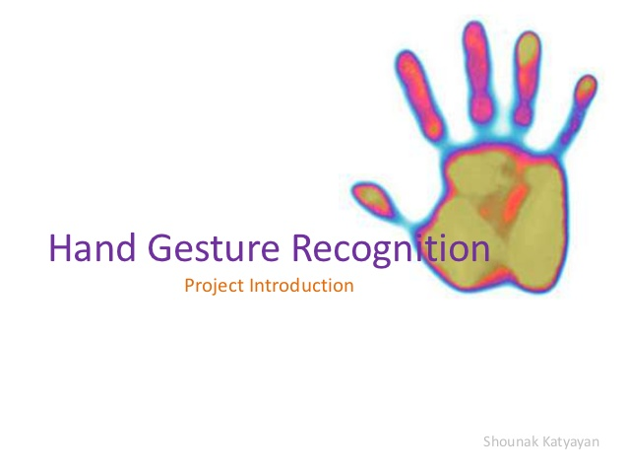

Slide 3
Contents
What is Hand-Gesture Recognition?
Why using Hand-Gesture Recognition?
Implementation
OpenCV
Neural Networks
References

Slide 4
What is Hand-Gesture Recognition?
What are Gestures?
It is a form of non-verbal communication
Movement of the hands, face or other parts of the boy
What is Gesture Recognition?
The gesture recognition interface with computers using gestures of the human body, typically hand movements

Slide 5
Why using Hand-Gesture Recognition?
This is useful for hands-free approach.
It is useful in media player .
For e.g. : A simple gesture could pause or play the movie or increase the volume even while sitting afar from the computer screen

Slide 6
Implementation
We are going to implement a system that recognizes gestures
We are inputting gestures using webcam and it performs specified operations
We are using OpenCV to recognize the gestures of hand
We are using Neural Network to recognize the gestures input and initialize some task to this input

Slide 7

OpenCV
OpenCV (open source Computer Vision Library) is an open source computer vision and machine learning vision library.
OpenCV is use to detect :
recognize faces identify classify human actions in videos,
Track camera moments
Track moving objects

Slide 8
Computer Vision Concepts
What computers see
Computers 'look' at images as multidimensional arrays or matrices but they can also be treated like functions (ex. taking the derivative over an image's x-axis).
Image Filters and Functions
Many times, images contain complex information that isn't need for a computation or reduces the speed of computation without much value added.

Slide 9
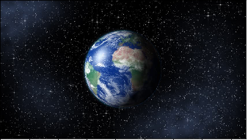
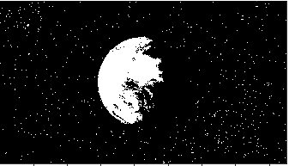
Continue…
Thresholding
Thresholding can be thought of as a function applied to each pixel of an image. This function takes a min and max thresholding values and if the pixel value falls in this range, it will 'return' the pixel, if not it will 'return' a black pixel.

Slide 10
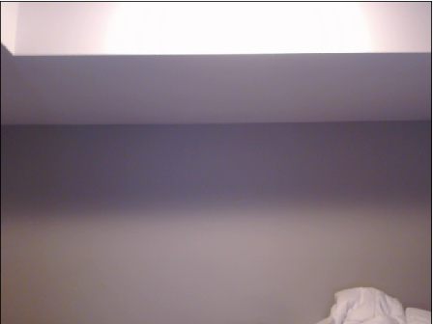
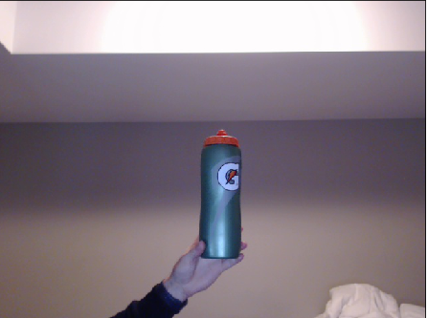
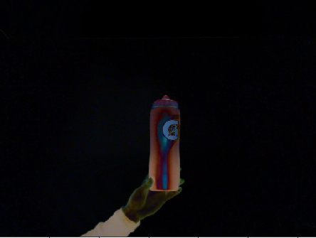
Background Subtraction

Slide 11
Intro to Machine Learning
Data guided
Trained on input and outputs
Predicts outputs given inputs
More data = more precise
Garbage in = Garbage out

Slide 12
NEURAL NETWORKS
Layers of hidden units
Inputs from previous layers multiplied by a “weight”, summed with a “bias”, then activated by a function
Weights and Biases are adjusted by automatically throughout training
Works similarly to a brain

Slide 13
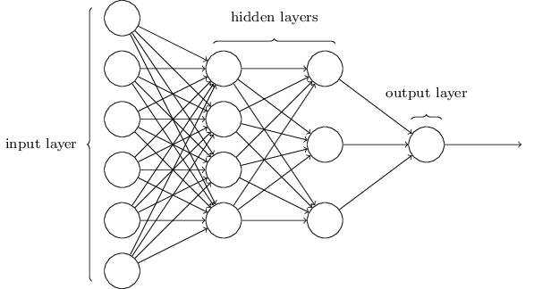

Slide 14
REFERENCES
https://opencv.org/
https://brohrer.github.io/how_convolutional_neural_networks_work.html

